Slide 1
DEPARTMENT OF BCA
FUNDAMENTALS OF MATHEMATICS
MODULE-1
MATRIX THEORY

Slide 2
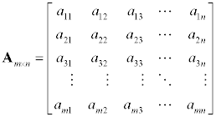
DEFINITION OF A MATRIX
A matrix is rectangular arrangement of elements enclosed in bracket.
If matrix has m-rows and n-columns then the order of matrix is said to be mxn.
The general form of a matrix is represented as
The elements operating in the i^{th} row and j^{th} column which is represented by a_{ij}
A_{mxn} = [a_{ij}] where i=1,2,3……..m and j=1,2,3…………n

Slide 3
Note:- Order of matrix = No. of rows X No. of columns. EXAMPLE FOR A MATRIX

Slide 4


TYPES OF MATRICES
SQUARE MATRIX: No. of rows = No. of columns.
RECTANGULAR MATRIX: No. of rows ≠ No. of columns.
COLUMN MATRIX: A matrix having only one column.
ROW MATRIX : A matrix having only one row.
$$A={\left[\begin{matrix}1 & 3 & 4 \\ 5 & 6 & 7\end{matrix}\right]}_{2x3}$$
$$A={\left[\begin{matrix}1 & 3 & 5\end{matrix}\right]}_{1x3}$$

Slide 5



TYPES OF MATRICES
DIAGONAL MATRIX : A matrix in which except principal diagonal elements are zero.
A=
SCALAR MATRIX : A matrix in which all the diagonal elements are equal.
UNIT MATRIX/ Idenity matrix: A scalar matrix in which diagonal element is 1.
ZERO MATRIX / NULL : A matrix in which all elements are zero.
$$A={\left[\begin{matrix}5 & 0 & 0 \\ 0 & 3 & 0 \\ 0 & 0 & 6\end{matrix}\right]}_{3X3}$$
$$A={\left[\begin{matrix}1 & 0 & 0 \\ 0 & 1 & 0 \\ 0 & 0 & 1\end{matrix}\right]}_{3X3}$$
$$A={\left[\begin{matrix}0 & 0 & 0 \\ 0 & 0 & 0 \\ 0 & 0 & 0\end{matrix}\right]}_{3X3}$$

Slide 6


RECTANGULAR MATRIX: A matrix having unequal no. of rows and columns.
Ex:-
UPPER TRIANGULAR MATRIX:
U =
LOWER TRIANGULAR MATRIX:
A=

Slide 7
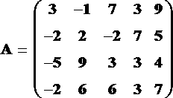
REAL MATRIX: A matrix in which all the elements are real nos.
SUB MATRIX: A matrix obtained from given matrix A by deleting some of its rows or columns or both.
B =
Therefore B is the Submatrix of A.

Slide 8
OPERATIONS OF MATRICES
EQUAL MATRIX OR EQUALITY OF MATRIX:
Two matrices A and B can be added or subtracted if and only if their dimensions are the same (i.e. both matrices have the same number of rows and columns. Take:
ADDITION OF MATRIX:
If A and B above are matrices of the same type then the sum is found by adding the corresponding elements a_{ij} + b_{ij} .
Here is an example of adding A and B together.

Slide 9
OPERATION OF MATRICES
SUBTRACTION OF A MATRIX:
If A and B are matrices of the same type then the subtraction is found by subtracting the corresponding elements a_{ij} − b_{ij}.
Here is an example of subtracting matrices.

Slide 10
MULTIPLICATION OF A MATRIX BY A SCALAR
If

Slide 11






PROBLEMS
Find 3A+4B and 5A-6B if
Find 4A+5B-6C and 3A-2B+5C if
A= B= C=
Verify 3(A+B) =3A + 3B if
A= B=
$$A=\left[\begin{matrix}2 & 3 \\ −2 & 4\end{matrix}\right] and B=\left[\begin{matrix}−5 & 0 \\ −2 & 1\end{matrix}\right]$$
$$\left[\begin{matrix}2 & 4 \\ 3 & −2\end{matrix}\right]$$
$$\left[\begin{matrix}1 & 3 \\ −2 & 5\end{matrix}\right]$$
$$\left[\begin{matrix}−2 & 5 \\ 3 & 4\end{matrix}\right]$$
$$\left[\begin{matrix}3 & 8 & 1 \\ 2 & −6 & 3 \\ 7 & 4 & −5\end{matrix}\right]$$
$$\left[\begin{matrix}4 & 0 & 2 \\ 6 & 2 & 3 \\ 1 & 3 & 2\end{matrix}\right]$$

Slide 12
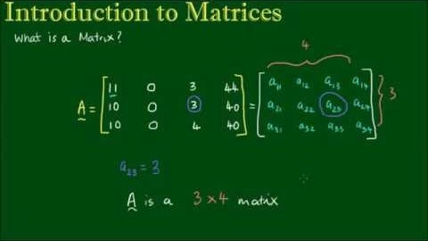

Slide 13


Slide 14
THANK YOU

